Slide 1
INTRODUCTION TO COMPUTER
Computer is an electronic semi-automatic device that takes input from the users process it and give output.

Slide 2
INPUT DEVICES
Input is all information put into a computer. Input can be supplied from a variety of sources:
Keyboard
Mouse
Scanner
Light pen
mic

Slide 3
OUTPUT DEVICES
The devices through which computer gives us the result of our inputs or the processed data
Monitor
Printer
Speaker

Slide 4
STORAGE DEVICES
The devices on which the computer stores their data
There are two types of storage devices
  Primary Storage
    ROM Read Only Memory
    RAM Random Access Memory
  Secondary Storage
    Hard disk ,IDE, HDD
    Floppy disk , FDD
    CD, DVD

Slide 5
CD, DVD, AND COMBO DRIVES
Compact Disk
Digital Versatile Disk
COMBO drive

Slide 6
DISK ARCHITECTURE
( Magnetic and optical disks)

Slide 7
STORAGE TECHNOLOGY
Magnetic storage devices store data by magnetizing particles on a disk or tape. They have a limited life-span of 1 to 5 years, depending on the device.
Optical storage devices store data as light and dark spots on the disk surface. They have an unlimited life-span.

Slide 8
MAGNETIC DISK
Hard disk
Floppy disk
Zip drive
Tape drive

Slide 9
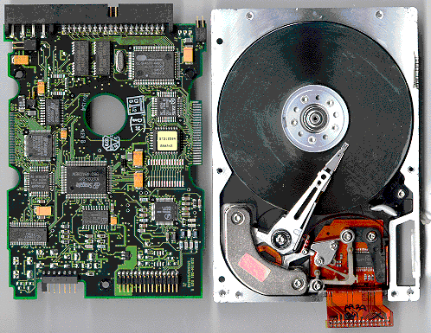
HARD DISK
Hard Disk Drives
Capacity is measured in gigabytes (GB or billions of bytes).
Typically permanently installed.
Used to store operating system, application software, utilities and data.
Magnetic storage device.

Slide 10
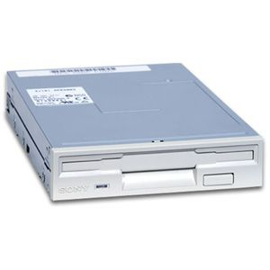
FLOPPY DISK
Floppy Disk Drives
Capacity is 1.44 to 2.0 megabytes (MB or millions of bytes).
  Storage device with the smallest capacity
  Most portable storage media
Magnetic storage device.

Slide 11
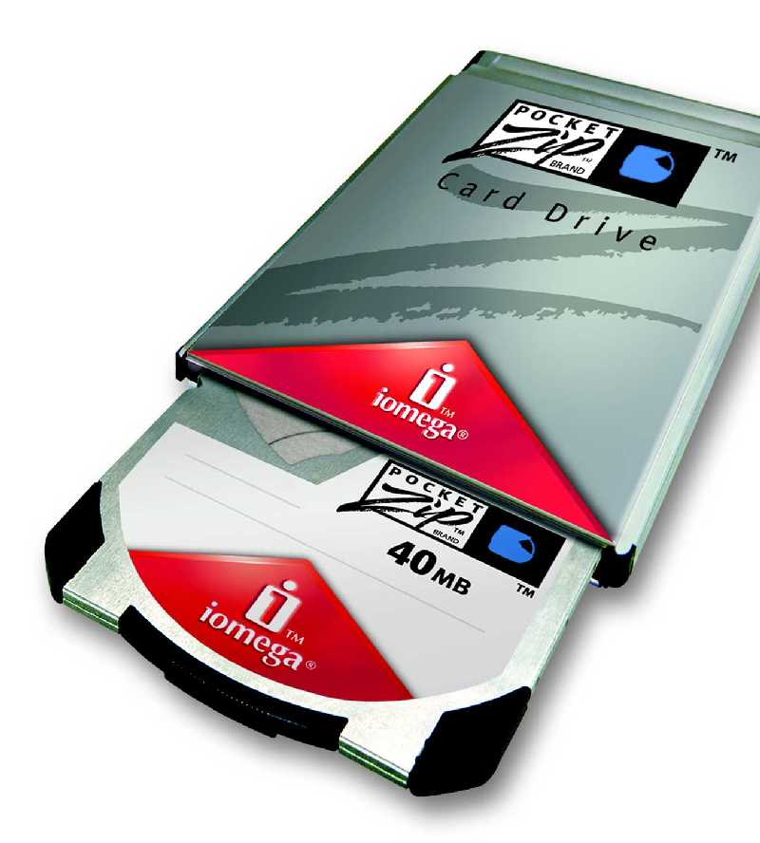
ZIP DRIVE
Other Types of Drives
Zip Drives – Several different capacities are available.

Slide 12
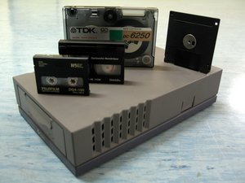
TAPE DRIVE
Tape Drives – Generally used for system backups, becoming less common.

Slide 13
OPTICAL DISKS
CD Rom
DVD
Combo Drive

Slide 14
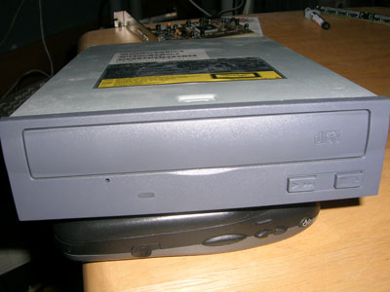
COMPACT DISKS
CD-ROM Drives
Typically installed on all new computer systems. (Were add-on device until the mid 1990’s).
Capacity is 600 to 750 megabytes

Slide 15
OPTICAL DISKS
CD-ROM Drives
Used more often now for backup storage as CD-RW (read/write) technology has become less expensive.
Data is read from CD by a laser.

Slide 16
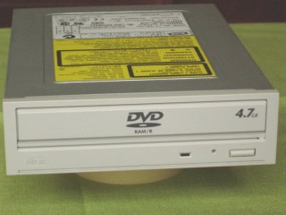
DVD
DVD drives – Can also read CDs, now more common as a standard device on new computer systems.

Slide 17
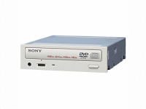
COMBO
All in One

Slide 18
PARTITIONS
Disk area may be divided up into different areas called partitions.
Partitions may belong to other O/S e.g. Unix, Windows
Information regarding partitions is kept in the partition table in first sector of hard disk.
Partition table is accessed by programs such as FDISK, which allows partition sizes, and the active partition, to be specified.

Slide 19
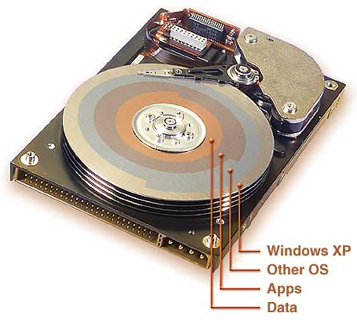
PARTITIONS

Slide 20
FAT
File Allocation Table
Fat generates the list of installed applications
And software's

Slide 21
FAT 16
File Allocation Table 16
File Allocation Table 16 is using for these
Operating systems only.
DOS
Windows 95 / 97
Windows NT (New Technology)

Slide 22
FAT 32
File Allocation Table
File Allocation Table 32 is using for these
Operating systems only.
DOS Windows XP Windows 98 Windows 2000 Windows ME

Slide 23
NTFS
New Technology File System
The new technology file system is using for
these Operating systems only.
Windows 2000
windows XP
Windows 2000 Server
Windows 2000 advanced server

Slide 24
PROCESSORS/CPU

Slide 25
CENTRAL PROCESSING UNIT - ALSO CALLED “THE CHIP”, A CPU, A PROCESSOR OR A MICROPROCESSOR
Micro Processor
Chip
CPU (Central Processing Unit )
IC (integrated circuits)

Slide 26
PROCESSOR TYPES
Processor have two types
1 slot 1 processor
2 socket processor

Slide 27
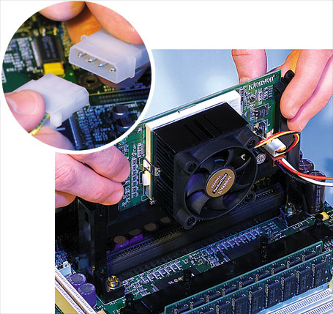
SLOT1 PROCESSOR
The slot1 Processor
Used in
Pentium l
Pentium ll
Pentium lll

Slide 28
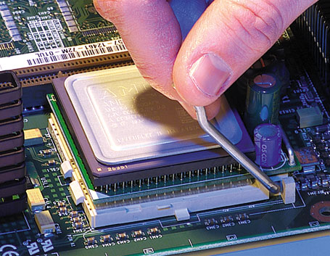
SOCKET PROCESSOR
The socket processor
are used in
Pentium l
Pentium lll
Pentium lV
Laptops

Slide 29
CPU
Central Processing Unit (CPU) - the actual hardware that interprets and executes the program (software) instructions and coordinates how all the other hardware devices work together

Slide 30
CPU consists by 3 main components
ALU (Arithmetic logic unit)
CU (control unit)
Registers

Slide 31
ARITHMETIC/LOGIC UNIT (ALU)
Arithmetic/logic unit (ALU) - performs all arithmetic operations (for example, addition, and subtraction) and all logic operations (such as sorting and comparing numbers)

Slide 32

ARITHMETIC
+
_
/
*
%
=
Arithmetic

Slide 33
LOGIC UNIT
<
>
>=
<=
<>
=
logic

Slide 34
CONTROL UNIT \ CU
Control unit - interprets software instructions and literally tells the other hardware devices what to do, based on the software instructions

Slide 35
REGISTERS STORE THE DATA
USED TO SUPPLY VALUES TO THE CU.
USED TO STORE THE RESULTS.
Registers

Slide 36
CPU PARTS
Register
ALU
CU

Slide 37
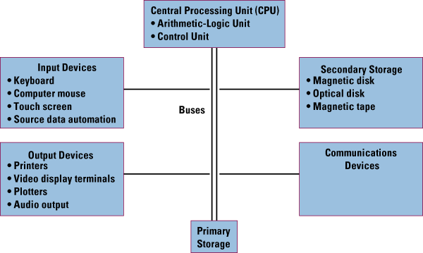

Slide 38
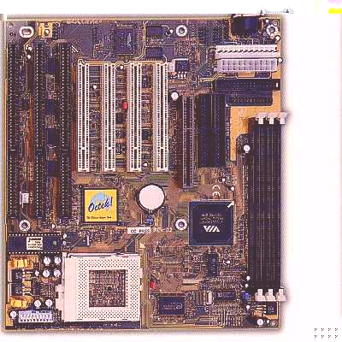
MAIN BOARD & MOTHER BOARD
2001 AgriTeach.comTM (12901ms)

Slide 39
MOTHERBOARDS
Are the biggest Part of the Computer
The CPU Plugs into the Mother Board
Other things that plug into the Mother Board.
  Expansion cards
  Hard and Floppy Drives
  Keyboard Mouse
  Printer & Scanner
  CD-ROM Drives, etc.

Slide 40
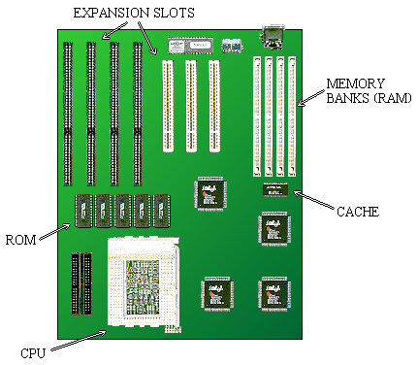
MOTHER BOARD

Slide 41
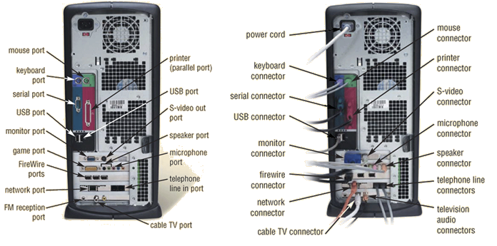
MOTHER BOARD & PORTS WITH CONNECTORS

Slide 42
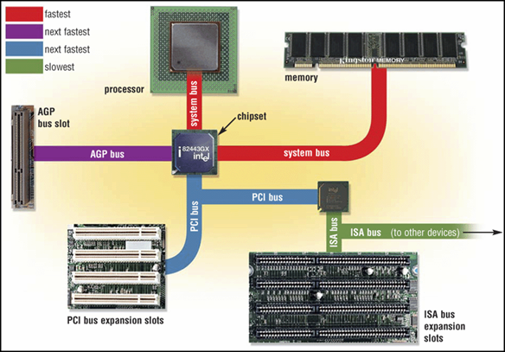

Slide 43
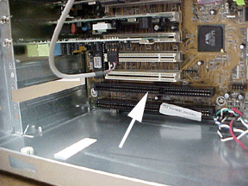
ISA BUS OR ISA SLOT
ISA Bus: Industry Standard Architecture
ISA slots can only handle 32 bits of data at a time.
A 32-bit ISA slot has 32 connections to the motherboard and can handle only 32 bits of data at a time.

Slide 44

PCI BUS OR SLOT
PCI Bus: Peripheral Component Interconnect
PCI slots can handle 64 bits of data at a time.
A 64-bit PCI slot has 64 connections to the motherboard. Each connection is capable of handling 1 bit of data at a time.

Slide 45
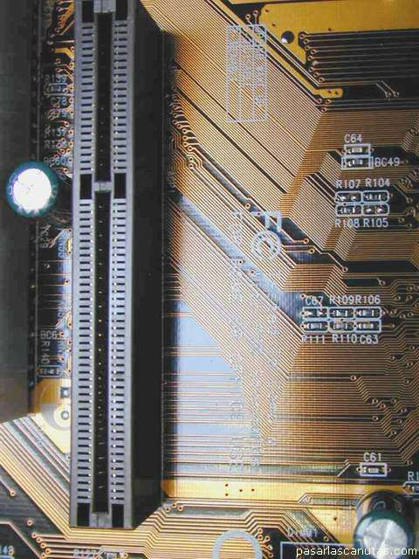
AGP BUS OR SLOT
AGP Bus: Accelerator Graphic Port
  Dedicated interface between memory and video card
Used for AGP video cards

Slide 46
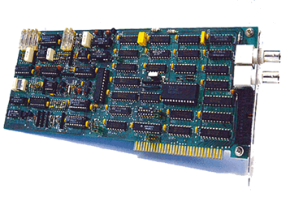
EXPANSION CARDS
Adds additional functions to motherboard
Plugs into “slots” of different types
Examples:
  Video Cards / AGP
  Sound Cards
  Network Cards
  Other “controller” cards

Slide 47
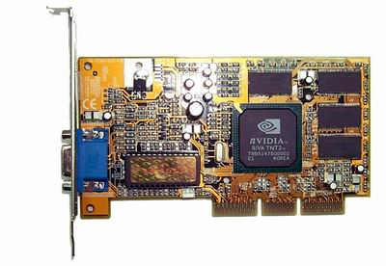
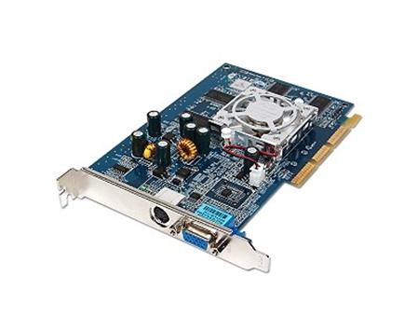
VGA & AGP CARDS

Slide 48
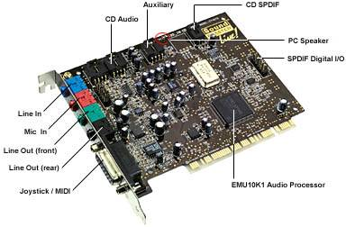
SOUND CARD

Slide 49
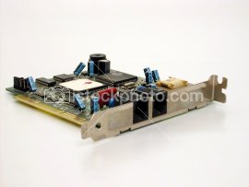
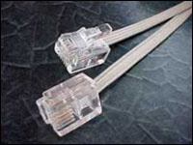
MODEM CARD

Slide 50
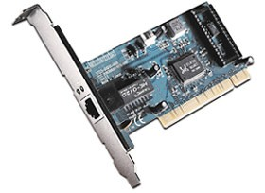
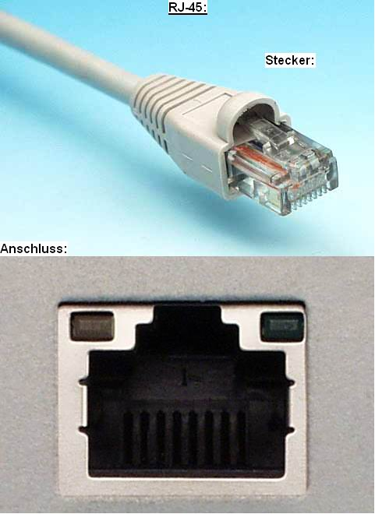
NETWORK CARD

Slide 51
JUMPERS
Jumpers are used to configure computer peripherals such as Hard Drives, Modems, Sound Cards, and various other

Slide 52
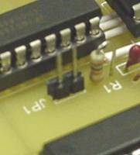
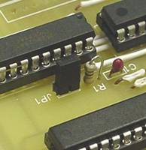
JUMPER
Jumper

Slide 53
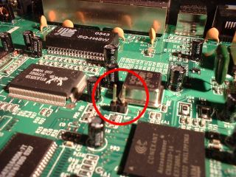
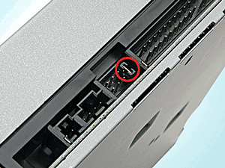
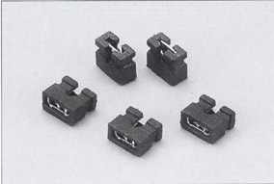
MOTHERBOARD / JUMPER

Slide 54
BIOS
BIOS – short for basic input/output system
The BIOS runs at the startup sequence where it configures devices and then boots the operating system.
The function of the BIOS is so vital that the information on the BIOS is stored on a ROM chip separate from the hard drive to protect it from potential crashes.

Slide 55
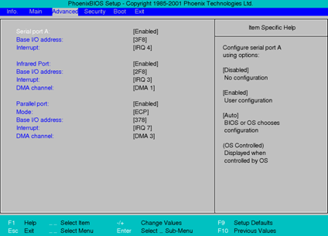
BIOS

Slide 56
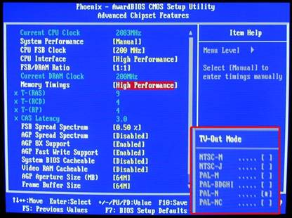
BIOS

Slide 57
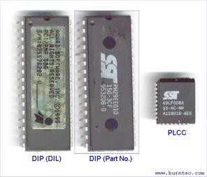
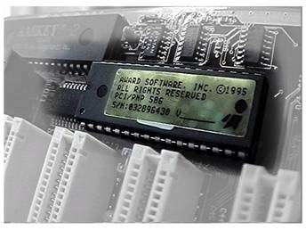
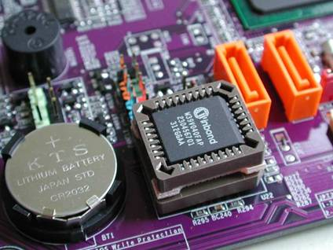
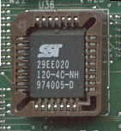
BIOS

Slide 58
DUAL-BOOTING
A computer with two operating systems. At startup, a boot manager program lets the user choose which one to load.

